Slide 1
Database Design - Normalization
Databases Systems [BS-IV(cs/se)] [Spring 2023]
Most of the content was taken from slides of book “Database System Concepts, 7th Ed, Silberschatz, Korth and Sudarshan”

Slide 2
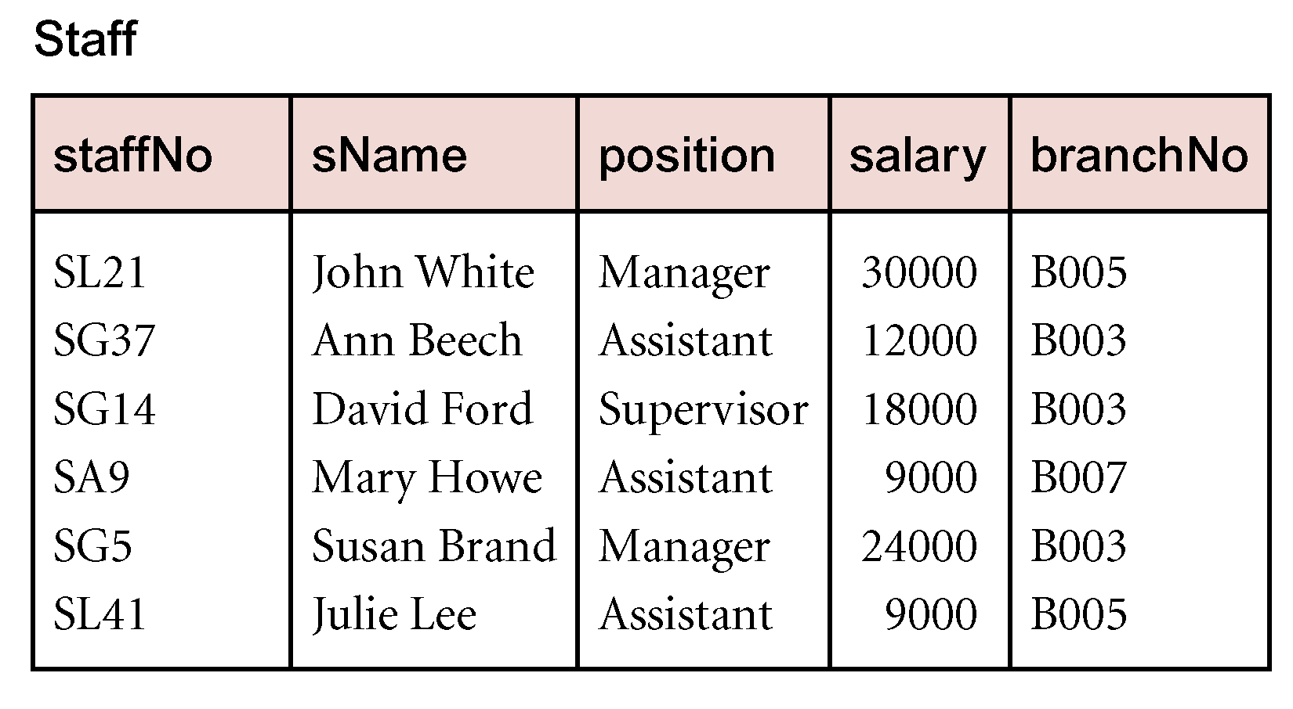
Example Functional Dependency that holds for all Time
Consider the values shown in staffNo and sName attributes of the Staff relation.
Based on sample data, the following functional dependencies appear to hold.
staffNo → sName
sName → staffNo

Slide 3
Example Functional Dependency that holds for all Time
However, the only functional dependency that remains true for all possible values for the staffNo and sName attributes of the Staff relation is:
staffNo → sName

Slide 4
Characteristics of Functional Dependencies
Determinants should have the minimal number of attributes necessary to maintain the functional dependency with the attribute(s) on the right hand-side.
This requirement is called full functional dependency.

Slide 5
Characteristics of Functional Dependencies
Full functional dependency indicates that if A and B are attributes of a relation, B is fully functionally dependent on A, if B is functionally dependent on A, but not on any proper subset of A.

Slide 6
Example Full Functional Dependency
Exists in the Staff relation.
staffNo, sName → branchNo
True - each value of (staffNo, sName) is associated with a single value of branchNo.
However, branchNo is also functionally dependent on a subset of (staffNo, sName), namely staffNo. Example above is a partial dependency.

Slide 7
Characteristics of Functional Dependencies
Main characteristics of functional dependencies used in normalization:
There is a one-to-one relationship between the attribute(s) on the left-hand side (determinant) and those on the right-hand side of a functional dependency.
Holds for all time.
The determinant has the minimal number of attributes necessary to maintain the dependency with the attribute(s) on the right hand-side.

Slide 8
Transitive Dependencies
Important to recognize a transitive dependency because its existence in a relation can potentially cause update anomalies.
Transitive dependency describes a condition where A, B, and C are attributes of a relation such that if A → B and B → C, then C is transitively dependent on A via B (provided that A is not functionally dependent on B or C).

Slide 9
Example Transitive Dependency
Consider functional dependencies in the StaffBranch relation
staffNo → sName, position, salary, branchNo, bAddress
branchNo → bAddress
Transitive dependency, branchNo → bAddress exists on staffNo via branchNo.

Slide 10
Functional Dependencies (Cont.)
Trivial − If a functional dependency (FD) X → Y holds, where Y is a subset of X, then it is called a trivial FD. Trivial FDs always hold.
Non-trivial − If an FD X → Y holds, where Y is not a subset of X, then it is called a non-trivial FD.
Completely non-trivial − If an FD X → Y holds, where x intersect Y = Φ, it is said to be a completely non-trivial FD.

Slide 11
Example - Using sample data to identify functional dependencies.
Function dependencies between attributes A to E in the Sample relation.
A → C (fd1)
C → A (fd2)
B → D (fd3)
A, B → E (fd4)

Slide 12
Lossless-join and Dependency Preservation Properties
Two important properties of decomposition.
Lossless-join property enables us to find any instance of the original relation from corresponding instances in the smaller relations.
Dependency preservation property enables us to enforce a constraint on the original relation by enforcing some constraint on each of the smaller relations.

Slide 13
Example of Dependency Preservation
R(A B C D)
FD₁: A ➔ B
FD₂: B ➔ C
FD₃: C ➔ D
Decomposition: R₁(A B C) R₂(C D)

Slide 14
FD₁: A ➔ B
FD₂: B ➔ C
FD₃: C ➔ D
R₁( A B C )
FD₁
FD₂

Slide 15
FD₁: A ➔ B
FD₂: B ➔ C
FD₃: C ➔ D
R₂( C D )
FD₃

Slide 16
FD₁: A ➔ B
FD₂: B ➔ C
FD₃: C ➔ D
R₁( A B C ) R₂( C D )
FD₁
FD₃
FD₂
Has all 3 functional dependencies!
Therefore, it’s preserving the dependencies

Slide 17
Example of Non-Dependency Preservation
R(A B C D)
FD₁: A ➔ B
FD₂: B ➔ C
FD₃: C ➔ D
Decomposition: R₁(A C D) R₂(B C)

Slide 18
FD₁: A ➔ B
FD₂: B ➔ C
FD₃: C ➔ D
R₁( A C D )
FD₃

Slide 19
FD₁: A ➔ B
FD₂: B ➔ C
FD₃: C ➔ D
R₂( B C )
FD₂

Slide 20
FD₁: A ➔ B
FD₂: B ➔ C
FD₃: C ➔ D
R₁( A C D ) R₂( B C )
FD₃
FD₂
Does not support FD₁: A => B
Therefore, it does not preserve the dependencies

Slide 21
More Example
R(A B C D E)
FD₁: A ➔ B
FD₂: BC ➔ D
Decomposition: R₁(A C E) R₂(B C D) R₃(A B)
Notes:
not

Slide 22
R(A, B, C, D, E, F )
FD₁: D ➔ A, B
FD₂: C ➔ E, F
Decomposition: R₁( A, C, D ) R₂( A, D, B ) R₃( D, E, F ) R₄( C, E, F )
Notes:
yes

Slide 23
Closure of a Set of Functional Dependencies
Given a set F set of functional dependencies, there are certain other functional dependencies that are logically implied by F.
For e.g.: If A → B and B → C, then we can infer that A → C
The set of all functional dependencies logically implied by F is the closure of F.
We denote the closure of F by F⁺.

Slide 24
Closure of a Set of Functional Dependencies
We can find F^{+,} the closure of F, by repeatedly applying Armstrong’s Axioms:
if β ⊆ α, then α → β (reflexivity)
if α → β, then γ α → γ β (augmentation)
if α → β, and β → γ, then α → γ (transitivity)
These rules are
sound (generate only functional dependencies that actually hold), and
complete (generate all functional dependencies that hold).

Slide 25
Example
some members of F⁺
A → H
by transitivity from A → B and B → H
AG → I
by augmenting A → C with G, to get AG → CG and then transitivity with CG → I
CG → HI
by augmenting CG → I to infer CG → CGI,
and augmenting of CG → H to infer CGI → HI,
and then transitivity
R = (A, B, C, G, H, I) F = { A → B A → C CG → H CG → I B → H}

Slide 26
Closure of Functional Dependencies (Cont.)
Additional rules:
If α → β holds and α → γ holds, then α → β γ holds (union)
If α → β γ holds, then α → β holds and α → γ holds (decomposition)
If α → β holds and γ β → δ holds, then α γ → δ holds (pseudotransitivity)
The above rules can be inferred from Armstrong’s axioms.

Slide 27
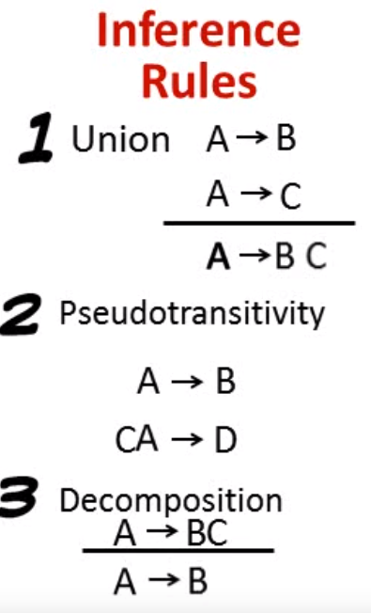
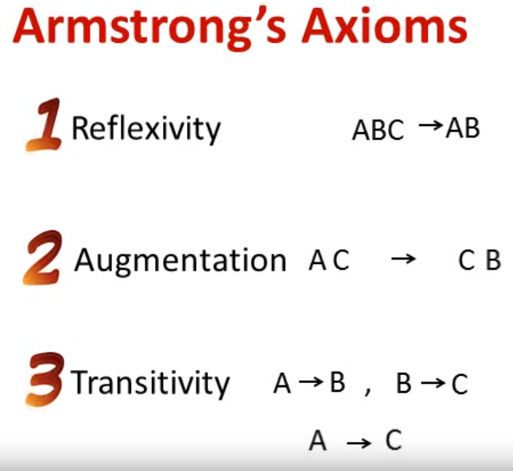
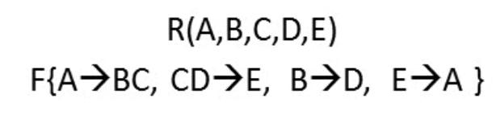

Slide 28
Closure of Attribute Sets
Given a set of attributes α, define the closure of α under F (denoted by α⁺) as the set of attributes that are functionally determined by α under F
Algorithm to compute α⁺, the closure of α under F
result := α; while (changes to result) do for each β → γ in F do begin if β ⊆ result then result := result ∪ γ end

Slide 29
Example of Attribute Set Closure
(AG)⁺
1. result = AG
2. result = ABCG (A → C and A → B)
3. result = ABCGH (CG → H and CG ⊆ AGBC)
4. result = ABCGHI (CG → I and CG ⊆ AGBCH)
Is AG a candidate key?
Is AG a super key?
Does AG → R? == Is (AG)⁺ ⊇ R
Is any subset of AG a superkey?
Does A → R? == Is (A)⁺ ⊇ R
Does G → R? == Is (G)⁺ ⊇ R
R = (A, B, C, G, H, I) F = { A → B
A → C CG → H CG → I B → H}

Slide 30
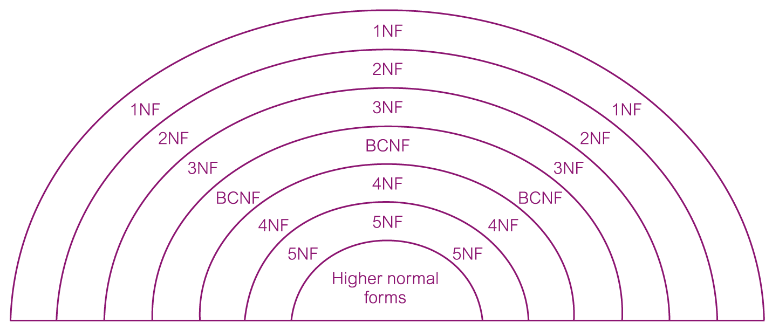
The Process of Normalization
As normalization proceeds, the relations become progressively more restricted (stronger) in format and also less vulnerable to update anomalies.

Slide 31
Normalization Process

Slide 32
Unnormalized Form (UNF)
A table that contains one or more repeating groups.
To create an unnormalized table
Transform the data from the information source (e.g. form) into table format with columns and rows.

Slide 33
First Normal Form (1NF)
A relation in which the intersection of each row and column contains one and only one value.

Slide 34
UNF to 1NF
Nominate an attribute or group of attributes to act as the key for the unnormalized table.
Identify the repeating group(s) in the unnormalized table which repeats for the key attribute(s).
Remove the repeating group by
Entering appropriate data into the empty columns of rows containing the repeating data (‘flattening’ the table).
Or by
Placing the repeating data along with a copy of the original key attribute(s) into a separate relation.

Slide 35
Second Normal Form (2NF)
Based on the concept of full functional dependency.
Full functional dependency indicates that if
A and B are attributes of a relation,
B is fully dependent on A if B is functionally dependent on A but not on any proper subset of A.
A relation that is in 1NF and every non-primary-key attribute is fully functionally dependent on the primary key.

Slide 36
1NF to 2NF
Identify the primary key for the 1NF relation.
Identify the functional dependencies in the relation.
If partial dependencies exist on the primary key remove them by placing them in a new relation along with a copy of their determinant.

Slide 37
Third Normal Form (3NF)
Based on the concept of transitive dependency.
Transitive Dependency is a condition where
A, B and C are attributes of a relation such that if A → B and
B → C,
then C is transitively dependent on A through B. (Provided that A is not functionally dependent on B or C).
A relation that is in 1NF and 2NF and in which no non-primary-key attribute is transitively dependent on the primary key.

Slide 38
2NF to 3NF
Identify the primary key in the 2NF relation.
Identify functional dependencies in the relation.
If transitive dependencies exist on the primary key remove them by placing them in a new relation along with a copy of their dominant.

Slide 39
General Definitions of 2NF and 3NF
Second normal form (2NF)
A relation that is in first normal form and every non-primary-key attribute is fully functionally dependent on any candidate key.
Third normal form (3NF)
A relation that is in first and second normal form and in which no non-primary-key attribute is transitively dependent on any candidate key.

Slide 40
Example - A Report

Slide 41
Example - UNF

Slide 42
Example - Normalization UNF to 1NF

Slide 43
Example - UNF to 1NF (Alternative)

Slide 44
FDs for Customer_Rental Relation
Primary key: Customer_No + Property_No
Full Functional Dependency:
(Customer_No+Property_No)->(RentStart, RentFinish)
Partial Dependency:
(Customer_No+Property_No)->Cname
(Customer_No+Property_No)->(Paddress, Rent, Owner_No, Oname)

Slide 45
Customer_Rental to 2NF Relations

Slide 46
Property_Owner to 3NF Relations
Transitive Dependency:
Property_No->Owner_No
Owner_No ->OName

Slide 47
Process of Decomposition

Slide 48
Summary

Slide 49

Example 2 - UNF

Slide 50

Table in 1NF

Slide 51

Tables in 2NF

Slide 52

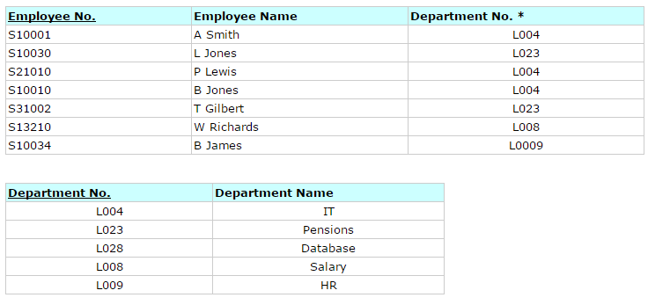
Tables in 3NF

Slide 53
Boyce-Codd Normal Form
A relation schema R is in BCNF with respect to a set F of functional dependencies if for all functional dependencies in F⁺ of the form
α→ β
where α ⊆ R and β ⊆ R, at least one of the following holds:
α → β is trivial (i.e., β ⊆ α)
α is a superkey for R
Example schema not in BCNF:
instr_dept (ID, name, salary, dept_name, building, budget )
because dept_name→ building, budget holds on instr_dept,
but dept_name is not a superkey

Slide 54
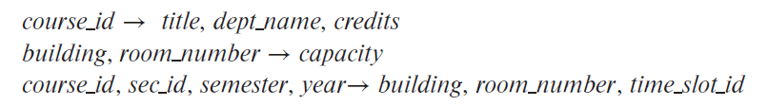
Boyce-Codd Normal Form
class (course_id, title, dept_name, credits, sec_id, semester, year, building, room number, capacity, time_slot_id)
Functional Dependency Set:
Key????

Slide 55
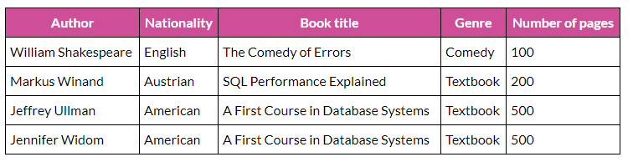

Slide 56
Normalization - Example
Cust.ID | Customer Name | Book Name | Shipping Address | Author | Author E-mail | Publisher | Publisher Contact | Price
1 | Ali | DBMS | Sukkur | a | a-yahoo.com | Pearson | 01-756 | 500
2 | Aamir | OS | Karachi | b | b-yahoo.com | Wiley | 01-111 | 300
3 | Sameer | DBMS | Islamaabad | a | a-yahoo.com | Pearson | 01-756 | 500
3 | Sameer | AI | Islamabad | b | b-yahoo.com | Wiley | 01-111 | 400
4 | Ali | OS | Karachi | b | b-yahoo.com | Wiley | 01-111 | 300

Slide 57
Normalization – 1NF
Cust.ID | Customer Name | Book Name | Shipping Address | Author | Author E-mail | Publisher | Publisher Contact | Price
1 | Ali | DBMS | Sukkur | a | a-yahoo.com | Pearson | 01-756 | 500
2 | Aamir | OS | Karachi | b | b-yahoo.com | Wiley | 01-111 | 300
3 | Sameer | DBMS | Islamaabad | a | a-yahoo.com | Pearson | 01-756 | 500
3 | Sameer | AI | Islamabad | b | b-yahoo.com | Wiley | 01-111 | 400
4 | Ali | OS | Karachi | b | b-yahoo.com | Wiley | 01-111 | 300
Key ???

Slide 58
Normalization – 2NF
Customer ID | Book Name
1 | DBMS
2 | OS
3 | DBMS
3 | AI
4 | OS
Book Name | Author | Author E-mail | Publisher | Publisher Contact | Price
DBMS | a | a-yahoo.com | Pearson | 01-756 | 500
OS | b | b-yahoo.com | Wiley | 01-111 | 300
DBMS | a | a-yahoo.com | Pearson | 01-756 | 500
AI | b | b-yahoo.com | Wiley | 01-111 | 400
OS | b | b-yahoo.com | Wiley | 01-111 | 300
Customer ID | Customer Name | Shipping Address
1 | Ali | Sukkur
2 | Aamir | Karachi
3 | Sameer | Islamaabad
3 | Sameer | Islamabad
4 | Ali | Karachi

Slide 59
Normalization – 2NF
Customer ID | Book Name
1 | DBMS
2 | OS
3 | DBMS
3 | AI
4 | OS
Book Name | Author | Author E-mail | Publisher | Publisher Contact | Price
DBMS | a | a-yahoo.com | Pearson | 01-756 | 500
OS | b | b-yahoo.com | Wiley | 01-111 | 300
AI | b | b-yahoo.com | Wiley | 01-111 | 400
Customer ID | Customer Name | Shipping Address
1 | Ali | Sukkur
2 | Aamir | Karachi
3 | Sameer | Islamaabad
4 | Ali | Karachi

Slide 60
Normalization – 3NF
Customer ID | Book Name
1 | DBMS
2 | OS
3 | DBMS
3 | AI
4 | OS
Customer ID | Customer Name | Shipping Address
1 | Ali | Sukkur
2 | Aamir | Karachi
3 | Sameer | Islamaabad
4 | Ali | Karachi
Book Name | Author | Publisher | Price
DBMS | a | Pearson | 500
OS | b | Wiley | 300
DBMS | a | Pearson | 500
AI | b | Wiley | 400
OS | b | Wiley | 300
Author | Author E-mail
a | a-yahoo.com
b | b-yahoo.com
a | a-yahoo.com
b | b-yahoo.com
b | b-yahoo.com
Publisher | Publisher Contact
Pearson | 01-756
Wiley | 01-111
Pearson | 01-756
Wiley | 01-111
Wiley | 01-111

Slide 61
Normalization – 3NF
Customer ID | Book Name
1 | DBMS
2 | OS
3 | DBMS
3 | AI
4 | OS
Customer ID | Customer Name | Shipping Address
1 | Ali | Sukkur
2 | Aamir | Karachi
3 | Sameer | Islamaabad
4 | Ali | Karachi
Book Name | Author | Publisher | Price
DBMS | a | Pearson | 500
OS | b | Wiley | 300
DBMS | a | Pearson | 500
AI | b | Wiley | 400
OS | b | Wiley | 300
Author | Author E-mail
a | a-yahoo.com
b | b-yahoo.com
Publisher | Publisher Contact
Pearson | 01-756
Wiley | 01-111

